Slide 1

Talent Academy Application and Appointment process
Play | About The Talent System (englandhockey.co.uk)
Notes:
Hello , I’m Sion Kitson, Talent Partnership Manager at England Hockey
This presentation is to provide information specific to the Talent Academy appointment process and is intended for clubs (or universities affiliated to England Hockey) interested in hosting a Talent Academy from September 2024.
There are some key documents and resources that I’d encourage you to read alongside this video.
Firstly, the Talent Academy Application and the Appointment Process Guidance document
The latest Talent Academy Framework which sets out the criteria under 8 elements. To be clear it’s the MVC, not the aspirational three-year criteria that we are interested in at the application stage. The Application and appendix of the Appointment Process details which of the criteria are required for the application process and what we are expecting to see in the application.
The other two resources which I hope will help you are related to the financial model, the Talent Academy budget template and the budget planning document.
Before we get into detail a reminder of the closing date for applications.
31th January at 5pm.

Slide 2
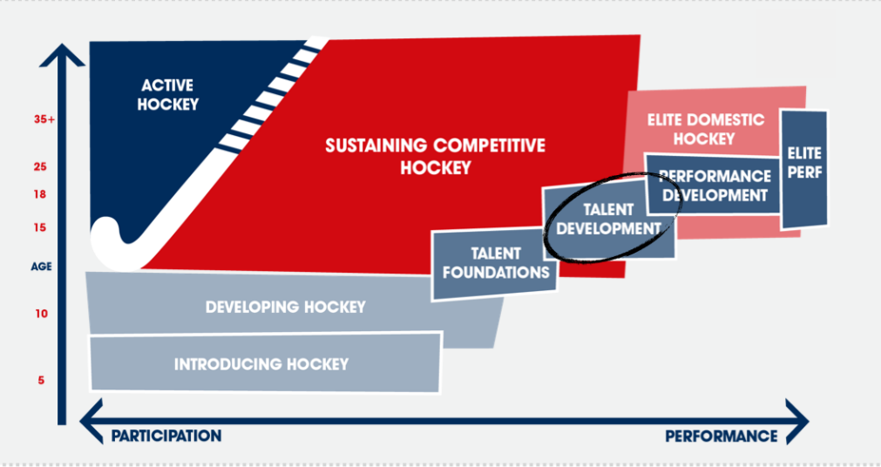
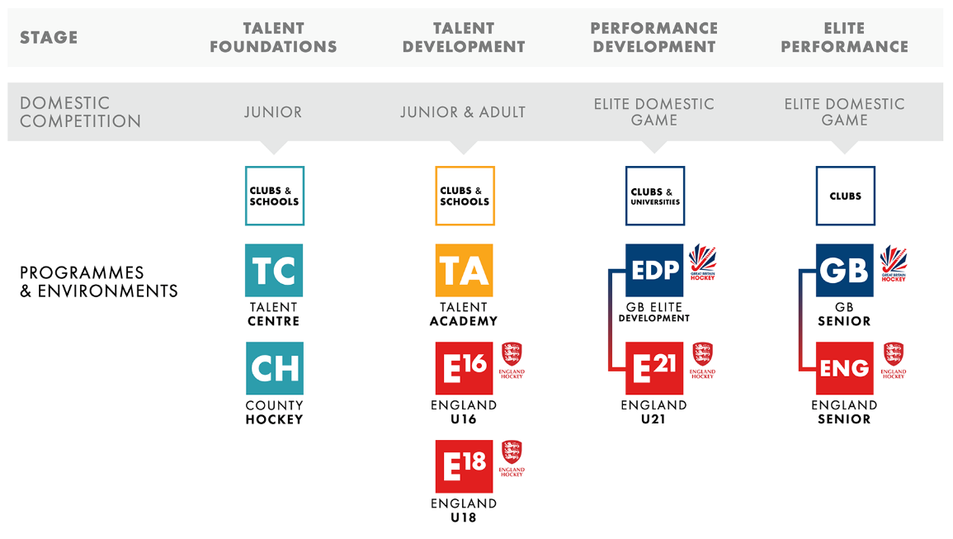
WhAT IS A TALENT ACADEMY?
Notes:
Before I get into the detail about how to apply. I want to recap on what a Talent Academy is.
Talent Academies are intended for players at the talent development stage.
Players at this level will identify as hockey players and be ready for a more intense and focused approach to their hockey development. At the top end of this stage players will have their first sight of International hockey at U16 or U18 level and be making lifestyle choices to support their hockey aspirations.
New Slide
Who are TAs for? Approximately 500 high potential players per gender demonstrating the intensity and commitment required to attend a TA.
TAs are one cohort per gender from u15 to u18. The player selection criteria provides guidance on the number of players per year group but this may differ slightly across TAs. You can find this guidance on the TA webpage.
Players not selected for TA are considered at the TF level and best catered for more locally via an appropriate blend of club, school and county hockey. This is why Talent Centre accreditation and the development of early talent development environments throughout the country is so important and starting to grow.
The main part of the TA programme is about serving a current talent pool - building a nationwide infrastructure for a small number of very high potential players and providing them the best opportunity to realise that potential,
It is the wider work that TA's will do combined with and the development of a large network of TCs and clubs/schools operating at equivalent levels which will bring about the transformational change we seek and a step change in access, diversity, and high quality basics.
The country has been divided into catchment areas and these catchments will evolve with the onboarding of new TAs from Sept 2023. The intention remains that it isn't for TAs to compete for players.
The number of players per TA will be approx. 25 and we anticipate you will have different types of player in your academy at any one time
- those who play all their club hockey at your club
- those who play their adult or junior hockey for a different club
- affiliate members - unlike the first two types they are unable to access on a regular basis but benefit from some connection with the TA. An example may be a player who lives on the Isle of Man and can't get to the mainland multiple times a week.
Overtime we expect the TA host to support and work collaboratively with other club's schools in its catchment area. Supporting the development of your catchment area is an important part of being a TA
New slide
I want to stress that a key principle of the new talent system is there are no pre-requisites to progressing to the next stage. There is no defined route to reach a TA and it is not a requirement to go to a Talent Academy to progress to national programmes.
New Slide
And finally a reminder about our 6 pillars - the 6 areas which we believe we need to both focus on and improve across the whole talent system if we are to transform both the quality of hockey players we produce and also the quality of the experience we provide for all high potential players.

Slide 3
PRE-REQUISITES
Evidence that the host can have ClubMark in place by 31st March 2024.
An identified (named) person who has the time, expertise, and influence to lead the development of a Talent Academy (note this does not need to be the Head Coach or the person who will eventually lead the delivery).
An identified (named) person who will be the Welfare Officer for the prospective Talent Team Academy.
Details of a viable financial model for the Talent Academy aligned to the financial principles set out in the supporting financial guidance.
Evidence of the junior pathway which sits around the Talent Academy for both genders including the stretch points and the provision of appropriate level adult hockey (National League / Area Premier).
Evidence that there are facilities available to the Talent Academies which meet the MVC, and that these can be made available to the Talent Academy while maintaining the current host’s delivery aligned to its development plan.
Notes:
We are very aware that the full appointment process is going to require a lot of work for potential hosts. We want the process to be open and transparent and give all clubs the opportunity to apply but with a dose of realism. Potential hosts need to have both the capacity and readiness to be a Talent Academy - or they won't be able to deliver to the standard expected – which may either impact the players and/ or other club members negatively.
That's why we've set out a series of pre-requisites which need to be met.
Club Mark - we won't be able to award a license if this isn't in place.
Named person and welfare officer.
Financial model - we don't need all the detail but need to see a model based on your situation / costs.
Pathway that sits around the TA.
Facilities to support the delivery of an exceptional environment.
It is important to state these are not just tick boxes but fundamentals to effective preparation and delivery.

Slide 4
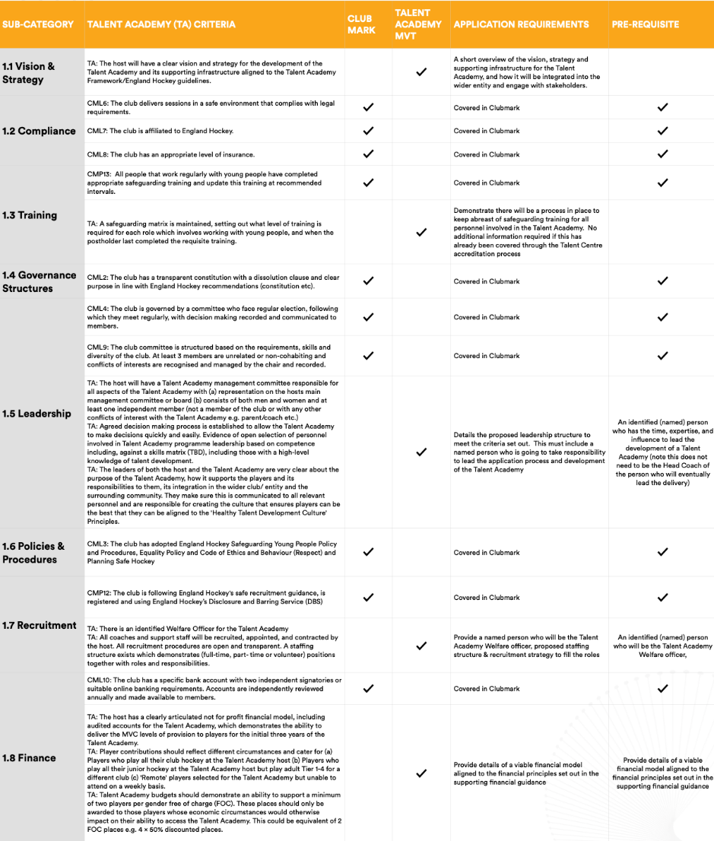
TALENT ACADEMY FRAMEWORK
LEADERSHIP AND GOVERNANCE
Notes:
The Talent Academy Framework sets out the minimum viable criteria that all TAs have to meet across 8 areas.
You will also see we’ve cross referenced the required criteria to EH club mark and the TC criteria. If you have already provided evidenced through one of these, just make reference to that, however this means completed. There is no need for duplicate evidence.
Here is a quick overview of each section.
LEADERSHIP AND GOVERNANCE
1.5: UNDERSTAND YOUR LEADERSHIP AND MANAGEMENT STRUCTURE, COMPOSITION, AT LEAST ONE INDEPEDENT PERSON, MAYBE 2 , ALSO LOOKING FOR NAMED PEOPLE TO PROVIDE CONFIDENCE THAT THERE ARE PEOPLE WHO HAVE AGREED TO TAKE ON THESE IMPORTANT ROLES.

Slide 5
TALENT ACADEMY FRAMEWORK
LEADERSHIP AND GOVERNANCE
COACHING
TALENT DEVELOPMENT ENVIRONMENTS
PLAYER DEVELOPMENT AND WELLBEING
Notes:
2. COACHING : AT THIS STAGE NOT NECESSARILY LOOKING TO KNOW WHO BUT WHAT THE STRUCTURE IS AND HOW YOU WILL GO ABOUT RECRUITMENT.
3. TALENT DEVEOPMENT ENVIRONMENTS - how are you proposing to deliver – when & where / bespoke session/ boys / girls / combined with other club sessions / this needs to link to your financial model. There are some other criteria in this section which I touched on earlier with regards to the pre-requisites. Facilities and locations for example.
- 4. PLAYER DEVELOPMENT AND WELLBEING: - WE REQUIRE CONFIDENCE THAT THE HOST WILL EMBRACE THESE ELEMENTS, WERE NOT ASKING FOR YOU TO DETAIL EVERYONE ONE BUT DEMONSTRATE HOW YOU PLAN TO. A LOT OF THIS COVERED IN TC.

Slide 6
TALENT ACADEMY FRAMEWORK
LEADERSHIP AND GOVERNANCE
COACHING
TALENT DEVELOPMENT ENVIRONMENTS
PLAYER DEVELOPMENT AND WELLBEING
CULTURE
EQUALITY, DIVERSITY & INCLUSION
STAKEHOLDERS
Notes:
5. CULTURE - THIS IS ABOUT BEING AWARE AND EMBEDDING the Healthy Talent Development Principles from understanding the 4 Ps, person, player, performance, partnership.
6. EDI – is about demonstrating inclusivity, how you will support access to the TA from a financial perspective / your plans and activities from an out reach programme perspective /as well as considering diversity within the TA workforce itself to promote a healthy environment and culture.
7. Partnerships – lastly partnerships is around effectively working with EH and local stakeholders as TA with schools, club and county associations to ensure all are working together to embed the principles of talent development putting the player at the heart.

Slide 7
TIMELINE
2024 New TAs confirmed with catchment areas
Longlist confirmed / Pre-requisites checked
Panel assessments
New TAs local assessments
ALL APPLICATIONS
5pm, 31st January
2024 Squads confirmed
Provisional list
TA player selection
Application deadline
Shortlist confirmed
Review window
TA onboarding
March
April
May
June
July
August
January
February
September
Notes:
This slide outlines the timeline for the application process. As highlighted the deadline for all applications is 5pm on January 31st.
We will then review all applications in line with the pre-requisites to establish a long list. We will ensure all applications receive 7 days to achieve the pre-requisites if not deemed in place initially.
Then during February & March we will support applicants to work towards the shortlist which will be confirmed around mid March.
At the end of March the Appointment Panels will take place and you can find the TofR for the panels available via the website.
Beyond the panel outcomes a provisional list of Talent Academies will be communicated in April leaving a review period before they are confirmed in early May.
Over the summer it will then be a case of supporting the newly appoints TAs with the finer plans and preparations most notably supporting player identification and selection, which may include some player reallocations (managed by EH) given the catchment areas will need amending slightly. Reallocations as in year 1 will be based on travel distance to home, school boarding or if they are already a member of the host TA
For further information on the player selection process can be found on the website.

Slide 8
Talent Academy Application and Appointment process
2024-25
Notes:
Finally, EH will welcome University and joint applications. Please read the sections within the guidance for further details.
If there are any geographical gaps remaining EH will continue to provide provision where appropriate.
It is important to end by saying TAs are supported by EH every step of the way but ultimately the delivery is driven and lead by each TA. Thank you for listening and we look forward to working with more interested applicants in the near future.

